Slide 1
PL-600 Conceptualize the design

Slide 2
Agenda
How to lead the requirement collection effort
Using fit gap analysis
Pillars of good architecture
Blueprinting the solution architecture

Slide 3
Where are we in the project?
Project is a go…we are done with pre-sales
Initiate
Design
Implement
Analyze
Deploy
Notes:
The work has been commissioned, we are done supporting pre-sales and now need to turn the vision into an implementation
These stages are only for helping us structure the conversation and don’t imply a methodology, in fact depending on the methodology used e.g. scrum/agile you may visit these stages many times during the project.

Slide 4
What is the most important question you can ask a client?
Classroom discussion
Notes:
WHY???
Knowing the reasons for a request or requirement helps bring out the root problem, not just a feature request

Slide 5
Solution Architect role at this point
Lead the discussions to evolve requirements to a level that a concrete solution can be designed
Identify the high-level components of the solution
Identify and create boundaries of what is in and out of scope and what integration is required
Propose proofs of concept to mitigate risk and/or provide needed clarification of proposed approaches

Slide 6
Evaluating requirements
How complete are they?
Look for common requirement problems
Look for gaps. What hasn’t been included?
Are regulatory, compliance and security requirements included and clear?
Develop a plan with the team to fill in the gaps and get to a point where you have usable requirements

Slide 7
What makes a good requirement?
Classroom discussion

Slide 8
Good requirements are…
Clear
Actionable
Feasible
Testable

Slide 9
Ensure clear requirements
Necessity
The requirement is not optional.
Cohesiveness
The requirement is not addressing more than one thing.
Business need criterion
Effective definition/description criteria
Criteria for ability to execute
Criterion for documentation adequacy
Consistency
Requirement is not at odds with another requirement.
Unambiguity
Requirement is not subject to interpretation.
Verifiability
Can be tested/demonstrated/inspected/analyzed.
Feasibility
Can be implemented within existing constraints.
Traceability
Documented and appropriately linked.
Notes:
http://en.wikipedia.org/wiki/Requirement#Characteristics_of_good_requirements
SMART requirements
INVEST user-story
As a talking point- how does this overall discussion make for a solution that you can actually deliver?

Slide 10



Who does the requirement serve?
Solution Perspective
Non functional Requirements
Data, Integration, Systems, Deployment Requirements
Scenarios
Personas (user / actor)
Business Perspective
Business Objectives
Outcomes
Scope
User Perspective
Notes:
usiness Perspective define the needs of the organization with regard to the solution. They define what the solution must deliver to capitalize on a business opportunity or to manage business challenges
User Perspective address interaction of individual or groups of users with the system to achieve their goal. These have a special focus on information delivery mechanisms
Solution Perspective includes
QoS (aka NFR) – Operability, Performance, Security, Usability etc.
Deployment Requirement - describe the customer’s processes for deployment and identify any issues or constraints that may influence the solution design
Integration & interoperability requirement - any factors that may arise relating to the customer’s Production Environment & other systems with which the solution must inter-operate and/or co-exist. This should include any details on interoperability standards and how they might affect the solution design.

Slide 11
Is it feasible?
Will the users use it?
Is it technically viable?
Is the process feasible?
Are we solving problems or symptoms?
Do regulatory rules or law make it not feasible?
Notes:
Throughout the process of collecting requirements you should always be looking out to ensure requirements are feasible. As you perform the fit gap analysis and are doing a pass on each of the requirements it’s a good time to do a double check on the feasibility. It’s possible that when the information was originally captured you didn’t have the benefit of other details that might make a requirement less feasible. Determining a requirement has feasibility challenges should result in it being re-evaluated with the subject matter experts or possibly de-prioritized.
Will the users use the feature?
Now that you have gotten to know the users more there are considerations. For example, will we be able to create a feature that not only meets a requirement, but one that users will actually use? This could be an automated process that is too complex and actually might result in too much rework for common scenarios. This could be a feature that while it might solve the problem, is solved by an overly complex solution.
Is it technically viable?
There is a saying that you don’t get what you don’t ask for. That is true of requirements too, often times users envision fancy solutions to their challenge. As you look at each requirement you should ask “Can we do this with the current technologies we have available?”. Along with this are we building something consistent with how the platform is designed to work, or are we pushing beyond the normal limits? For example, if the volume of requests is so high, we would overrun the API limits for protecting the platform implementing as planned would not be feasible.
Is the process feasible, or did we miss the process?
As you review the requirements, they might clearly call out a business process like resolving new cases or a sales process. That’s great, for those we need to only validate they are reasonable and implementable. We should look to ensure we’ve covered exceptions that occur on a regular basis. It’s also possible that ten requirements individually didn’t identify a process but now when evaluating them as a whole a business process becomes more identifiable.
Do regulatory rules/laws make a requirement not feasible?
If you’re working in a regulated industry you need to check requirements against a knowledgeable expert on what is allowed and not allowed. It is easy when collecting ideas to get excited about a requirement only to later reflect on how it isn’t feasible because it conflicts with a regulatory rule or law.
The bottom line, as you finish collecting requirements it is the perfect time to reflect on the full set of requirements and ensure they are feasible as you work through your fit gap analysis or design the solution from the requirements.

Slide 12
Bad requirements are..
Vague
Not measurable
Not feasible
Notes:
Engage students in a discussion of their experience with bad requirements

Slide 13
Common requirement problems
Rebuilding legacy systems
Excessive dependencies
Written for how it was done 10 years go when the system you are replacing was built
Have non-functional requirements been provided?
How many users? Application load profile? Etc.…
Notes:
This is not a complete list, but designed to get them thinking about problems that might exist – use it to start a discussion
Its also not uncommon that a customer will bring over a requirement that was really a limitation of the old system not something that helps them get the job done

Slide 14
Common requirement problems
Not clear, they aren’t implementable
Requirements that reference other requirements creating bottlenecks
Design requirements. Pre-suppose implementation
E.g. When checked, trigger Power Automate flow X
Requirement crosses boundaries that are out of scope
Notes:
This is not a complete list, but designed to get them thinking about problems that might exist – use it to start a discussion
Its also not uncommon that a customer will bring over a requirement that was really a limitation of the old system not something that helps them get the job done

Slide 15
Building better requirements
Elevate the discussion
Why does there need to be a checkbox?
Remove any design language
E.g. We don’t need to talk about plugins in requirements
Make it testable
Review the impact on other processes
Can you map it directly to a value?
Notes:
SA’s have to guide the team in some cases to get a good requirement. This starts with elevating it from design language and ending with something implementable and testable

Slide 16
What is the difference between functional and non-functional requirements?
Classroom discussion

Slide 17
Functional
Non-functional
As a sales user I need to be able to close an opportunity as lost and capture why it was lost so that we can improve our sales tactics in the future.
As a sales manager I need to be able to approve a discount on a quote so I can reduce the total price and give a discount to the customer.
As a staff accountant I want to be prevented from closing a batch that has pending items, so I do not have to re-open it later.
Availability
Compliance / regulatory
Data retention/residency
Performance (response time, etc.)
Privacy
Recovery time
Security
Scalability

Slide 18
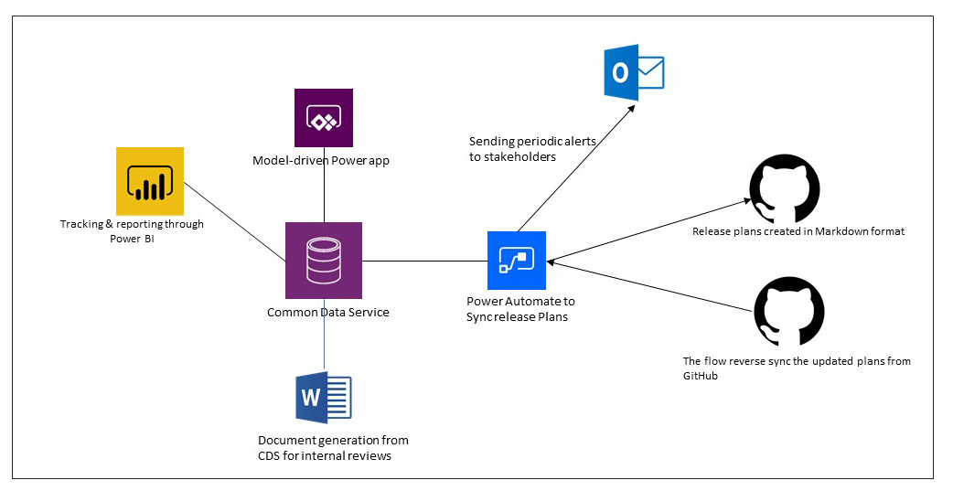
Blueprinting the solution architecture
High-level architecture diagrams can show how proposed solution architecture fits into overall enterprise architecture

Slide 19
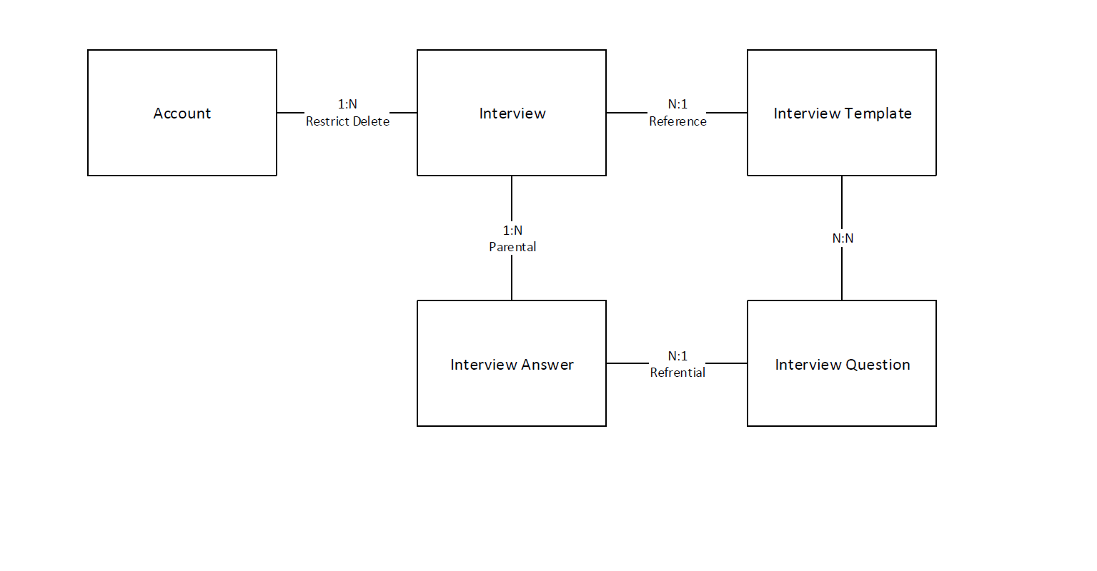
Blueprinting the solution architecture
Data model diagrams can illustrate key data relationships to support the solution architecture

Slide 20
Wrapping up
Ensuring requirements are clear, actionable, implementable is essential for being able to establish the solution architecture
Identifying gaps between built-in capabilities and requirements using fit gap allows design to cover how gap will be solved
The architecture pillars provide guidance on what a solution architect should consider to build a good business application architecture

Slide 21
Group exercise: Design from requirements
Evaluate project details
Complete project workbook
High-level architecture diagram
Dynamics 365 apps used
Fit gap

